Slide 1



Slide 2

Nachos: Present Status
Currently Nachos does not support multiprogramming.
Currently Nachos only implements halt system call.
No support for reading and writing from user program.
No support for running multiple thread spawning from user program (multithreaded user program).

Slide 3


Slide 4
User programs
All user level processes execute as a kernel-level thread in Nachos.
Nachos can run user programs as long as they make only those system calls that are understood by Nachos.
User program must be converted into appropriate format to run on MIPS architecture.

Slide 5
User programs (contd.)
Written in ANSI C, lack of many libraries like printf (examples in nachos-3.4/code/test/).
Reside in user address space (can see only data structures declared/created inside the program).
Communication with the kernel through system calls (open file, start a new process, etc.) defined in userprog/syscall.h.

Slide 6
Difference between Nachos executable and Linux executable
Linux executables are in coff format.
Nachos executables are in noff format.
There must be a way to convert the coff format into noff format.
See /code/bin/coff.h and /code/bin/noff.h

Slide 7
noff
Noff header
  Resides at the beginning of the file and describes the contents of rest of the file, giving info about the program’s instruction, initialized variables
  Noffmagic, header maintains a reserved magic number indicating that the file is in noff format.
  Before attempting to execute a file, nachos checks that number.

Slide 8
Makefile (~/test/makefile)
halt.o: halt.c
$(CC) $(CFLAGS) -c halt.c
halt: halt.o start.o
$(LD) $(LDFLAGS) start.o halt.o -o halt.coff ../bin/coff2noff halt.coff halt
The above compiles a user program called halt.c .
resulting object file is then linked with another file called start.o to produce a binary called halt.coff .
Since we want to run halt.c in Nachos, we then invoke the program coff2noff to produce a binary file called halt in the Noff format.

Slide 9
Makefile contd.
1 all: halt shell matmult sort
2 start.o: start.s ../userprog/syscall.h
3 $(CPP) $(CPPFLAGS) start.s > strt.s
4 $(AS) $(ASFLAGS) -o start.o strt.s
5 rm strt.s
6 shell.o: shell.c
7 $(CC) $(CFLAGS) -c shell.c
8 shell: shell.o start.o
9 $(LD) $(LDFLAGS) start.o shell.o -o shell.coff
10 ../bin/coff2noff shell.coff shell
Makefile to compile and run shell.c

Slide 10
Makefile contd.
Lines 2-5 generate object code for start.s.
Lines 6 and 7 generate object code for shell.c.
Lines 8 and 9 produce an executable binary.
  Note: listing start.o before shell.o ensures that the code for start.s resides before that of the main program.
Line 10 translates the binary into the Noff format. shell, is thus, an executable ready to execute under Nachos.

Slide 11
What is start.s?
The file start.s contains assembly language code that needs to be executed before the code of each user program's main routine.
For proper execution of shell.c , we need to make sure that the code in start.s resides before that of its main program.
In addition to containing this initialization code, start.s also contains stub modules for invoking system calls .

Slide 12
What is start.s?
Specifically, the very first instruction in start.s calls the user-supplied main routine, whereas the second instruction invokes the Nachos Exit system call, insuring that user processes terminate properly when their main program returns.

Slide 13
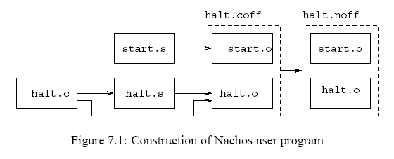
Construction of Nachos User Program
Construction of Nachos User Program

Slide 14


Slide 15
System Call in Nachos
Nachos kernel serves user programs via system calls.
System call causes an exception (interrupt) and changes from user mode to kernel mode.
As a result the exception handler is called eventually (userprog/exception.cc).
Arguments are placed in registers r4 - r7.
Return value – in r2 (see userprog/exception.cc)

Slide 16
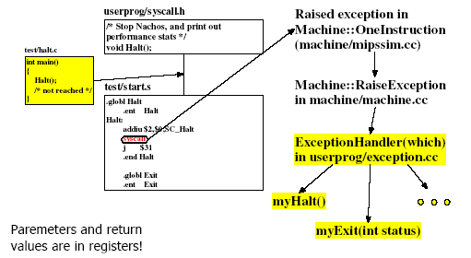

Slide 17
System Call in Nachos
Need to perform following steps -
get the parameters for the system call from registers.
convert any pointers (ie, char* pointers) from virtual to physical addresses.
pass the parameters to corresponding system call handler.
place the return value in the appropriate register.

Slide 18
System Call in Nachos
ExceptionHandler parameter identifies exception
If it’s a system call:
  R2: system call code (defined in syscall.h)
  R4: arg1
  R5: arg2
  R6: arg3
  R7: arg4
  Return any result in R2.

Slide 19
System Call in Nachos
Void Write(char* buf, int size, openFileID id);
R2 = SC_Write
R4 = &buf
R5 = size
R6 = id

Slide 20
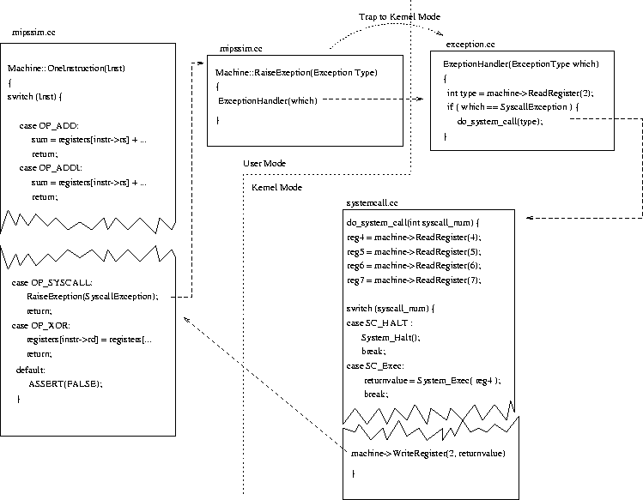
System call number is in register 2
Argument list
Return value is
Sent through register 2

Slide 21
Code Example
void ExceptionHandler(ExceptionType which) {
int type = machine->ReadRegister(2);
if (which == SyscallException) {
switch(type) {
case SC_Halt: {
DEBUG('a', "Shutdown, initiated by user program.\n");
interrupt->Halt();
}
case SC_Create: {
// your code;
break;
}
}

Slide 22
Code Tips for system call
infinite system call loop : Re-executing the syscall instruction after returning from the system call.
Solution: update PCReg to point to the instruction following the syscall instruction.
The following code properly updates the program counter.

Slide 23
Code Tips [must be added]
pc = machine->ReadRegister(PCReg)
Machine->WriteRegister(PrevPCReg,pc)
Pc=machine->ReadRegister(NextPCReg)
Machine->WriteRegister(PCReg,pc)
pc += 4
Machine->WriteRegister(NextPCReg,pc)

Slide 24
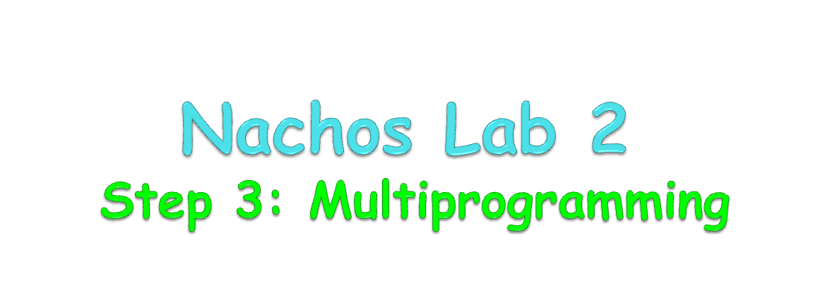

Slide 25
How a user program is loaded in main memory?
Remember that when you start Nachos, it automatically creates a “main” kernel thread that takes care of initializing Nachos and running the user program, turning on debugging, etc.
It then calls StartProcess() [see /userprog/progtest.cc].

Slide 26
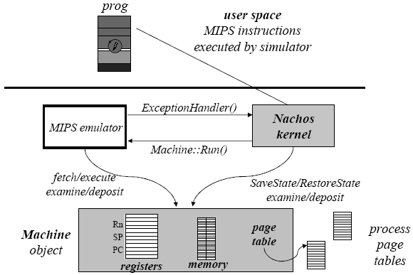

Slide 27
How a user program is loaded in main memory?
Inside StartProcess(), nachos initializes a new AddrSpace for the executable that
  Allocates necessary memory for loading the user program.
  Maintains a page table for virtual to physical memory mapping.

Slide 28
Implementation in Address Space
See /userprog/addrspace.cc.
AddrSpace has two private variables – pageTable and numPages.
Closely look the constructor.
  How address space is initialized.
  How page table info is populated.
  How the user program is loaded into main memory.

Slide 29
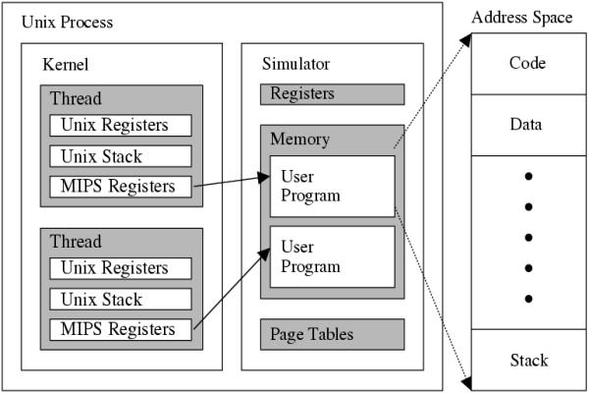
Inside Nachos Process: Nachos Kernel,
Machine Simulator, User Programs

Slide 30
Implementation in Address Space
pageTable = new TranslationEntr [numPages];
for (i = 0; i < numPages; i++){
    pageTable[i].virtualPage = i;
    pageTable[i].physicalPage = i;
    pageTable[i].valid = TRUE;
    pageTable[i].use = FALSE;
    pageTable[i].dirty = FALSE;
    pageTable[i].readOnly = FALSE;
}
You must change it to support multiprogramming.

Slide 31
Implementation in Address Space
ReaAt() is used to read data from a specified memory location.
Remember, the address must be physical memory location.
As nachos only supports one user program, there is one to one mapping between virtual and physical memory address.

Slide 32
Implementation in Address Space
Can you tell why nachos works although there is no conversion from virtual to physical address?
Because….
See previous slides (One to one mapping).
In case of multiprogramming, that will not work.
You may need a virtual to physical memory address converter.

Slide 33
Loading user program
After all initialization, machine->Run() is called for each process.
It actually invokes the MIPS simulator.
MIPS simulator then fetches one instruction at a time and executes it.
How does it work?

Slide 34
Running Multiple User Programs
Program_A.c
Program_B.c
Program_C.c
int main() {
Write("Program A\n",10,1);
Write("Program A\n",10,1);
Write("Program A\n",10,1);
Write("Program A\n",10,1);
Write("Program A\n",10,1);
Write("Program A\n",10,1);
Write("Program A\n",10,1);
Write("Program A\n",10,1);
Write("Program A\n",10,1);
Write("Program A\n",10,1);
Halt();
}
int main() {
Write("Program B\n",10,1);
Write("Program B\n",10,1);
Write("Program B\n",10,1);
Write("Program B\n",10,1);
Write("Program B\n",10,1);
Write("Program B\n",10,1);
Write("Program B\n",10,1);
Write("Program B\n",10,1);
Write("Program B\n",10,1);
Write("Program B\n",10,1);
Write("Program B\n",10,1);
Write("Program B\n",10,1);
Write("Program B\n",10,1);
Write("Program B\n",10,1);
Write("Program B\n",10,1);
Halt();
}
int main() {
Write("Program C\n",10,1);
Write("Program C\n",10,1);
Write("Program C\n",10,1);
Write("Program C\n",10,1);
Write("Program C\n",10,1);
Write("Program C\n",10,1);
Write("Program C\n",10,1);
Write("Program C\n",10,1);
Write("Program C\n",10,1);
Write("Program C\n",10,1);
Write("Program C\n",10,1);
Halt();
}

Slide 35
Running Multiple User Programs
Sample Execution
> ./nachos –x a b c
    Loading program: a
    Number of pages: 12
    Size of code segment: 656
    Virtual address of code segment: 0
    Size of read only data segment: 96
    Virtual address of read only data segment: 656
    Program A
    Program A
    ………

Slide 36
Running Multiple User Programs
    ### Context Switch: current = Program_A, selected = Program_B
    Program B
    Program B
    ………….
    ### Context Switch: current = Program_B, selected = Program_C
    Program C
    Program C
    ………….

Slide 37
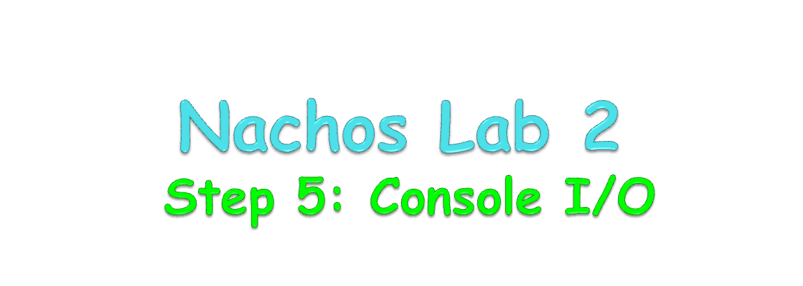

Slide 38
Console Implementation in Nachos
User program can’t directly read from or write to console.
Multiple program may compete for console access.
So, there must be some synchronization.
See /machine/console.h & /machine/console.cc.
Also see ConsoleTest() in /userprog/progtest.cc.

Slide 39
Console: Creation
Create an object of the Console class during Nachos startup ( Initialize() function in threads/system.cc).
Provide global access for that object (global variable in threads/system.h).

Slide 40
Console Interrupts
Q: How console interrupts are handled in Nachos?
A: The functions are called, which are provided as arguments during console creation in the constructor (may be written by you):
Console::Console(char *readFile, char *writeFile, VoidFunctionPtr readAvail, VoidFunctionPtr writeDone, int callArg);
Check example in userprog/progtest.cc.

Slide 41
Console: Output
Write one character at a time – Console::PutChar()
TRANSMIT COMPLETE interrupt when finished.
User-supplied handler is invoked (the function provided as an arguments during console creation).
Implement ability to print any string, not only chars for Write() system call.

Slide 42
Console: Input
One character at a time
Console::GetChar() always return immediately: a char or EOF if nothing in the buffer.
Interrupt generated when a key is stricken.
Use synchronization primitives to avoid active waiting in the loop.
Unix issue: in the lab environment a string is send from Unix to nachos program only after “Enter” is pressed.

Slide 43
Read/Write from user program
Implement a new class SynchConsole with synchronization facilities similar to ConsoleTest().
SynchConsole:Write(char *) – writes provided string to console synchronously.
SynchConsole:Read(char*) – reads from console and copies to string.

Slide 44
How does user program read/write?
Through system call – read and write.
Tips: You have to read the string from the user space memory to kernel space using Machine->readMem() and then write using synchConsole.
Similarly, you have to write the string to user space from kernel space using machine->writeMem() after reading it using synchConsole.

Slide 45


Slide 46
What Files Do I Change?
The following files may require changes or close attention to get a feel for what is going on.
  Any code wrapped in #ifdef USER_PROGRAM ... #endif will be included when you compile Nachos.
  exception.cc - This is where the actual code for your syscalls will go. So your Fork syscall could be a function called ForkSyscall() in this file.
  machine.h – change numPhysPage 32 to 128.

Slide 47
What Files Do I Change?
system.cc
  You should need to make minimal changes to this file. You may need to allocate any new operating system structures here.
addrspace.cc and addrspace.h
  This is where code related to managing user-space memory
should go.
Examining how stack space is allocated for a new process (see InitRegisters) might repay some extra attention.
syscall.h
  You will find the syscall numbers and the prototypes (not the actual syscall function) of the syscalls here.
So the syscall function call in your user program must follow exactly this format.

Slide 48
User program Tips
Upon console I/O, the console device, schedules interrupts into the future to poll the console for characters. This may cause Nachos to continue execution even after all user process have finished and there are no more threads on the ready list. To get around this, user programs should call Halt() when they have finished execution.

